Slide 1
San José Neighborhoods Commission
Larry Ames, March 17, 2018

Slide 2
Purpose of N’ghbrhds Commission
“The Neighborhoods Commission shall integrate the voice of neighborhoods into the City’s decision-making processes”
“The Neighborhoods Commission is advisory to the City Council regarding San José neighborhoods.”
Budget
Code Enforcement
Community Engagement
Public Safety
Transportation
Independent Citizens Oversight Standing Cmte
Empower the neighborhoods

Slide 3
History
2002: Strong Neighborhood Initiative (SNI) to assist ~1/3rd of city
2007 (→’08): SNI Project Advisory Committee (PAC) “sunsetted”. To continue community/City dialog & involve whole city, City establishes Nghbrhd Com’sn
“Pilot Program”: Caucuses in mid 2008; 1 year delay in seating; First meeting in July 2009.
2-year “Trial Program” ended & extended several times; made permanent Oct 2013
summer 2014: caucuses for odd-numbered districts
Aug 2014: first meeting of reconstructed Neighborhoods Commission

Slide 4
Relationship to DxNLG, UNSCC, …
neighborhood groups, large and small, across the city

Slide 5
Relationship to DxNLG, UNSCC, …
groups within a district can
meet to discuss regional issues
(e.g., in-fill and Diridon Station for D6NLG),
and to informally share ideas
(might include business districts, schools, libraries, etc.)

Slide 6
Relationship to DxNLG, UNSCC, …
United Neighborhoods of Santa Clara Co.
groups from across the County may participate in UNSCC
to learn techniques and share insurance & 501(c)3 funding

Slide 7
Relationship to DxNLG, UNSCC, …
San José Neighborhoods Commission
the community selects 2 residents to officially represent
all the neighborhoods within each city council district
on neighborhood issues of citywide import

Slide 8
Caucus Process
Commissioners
Council approval
candidates
(volunteers)
caucus
process*
overseen
by NC
caucus cmte
Delegates
* In case of mid-term vacancies,
the Councilmember of that district
appoints a replacement
from a pool of qualified candidates.

Slide 9
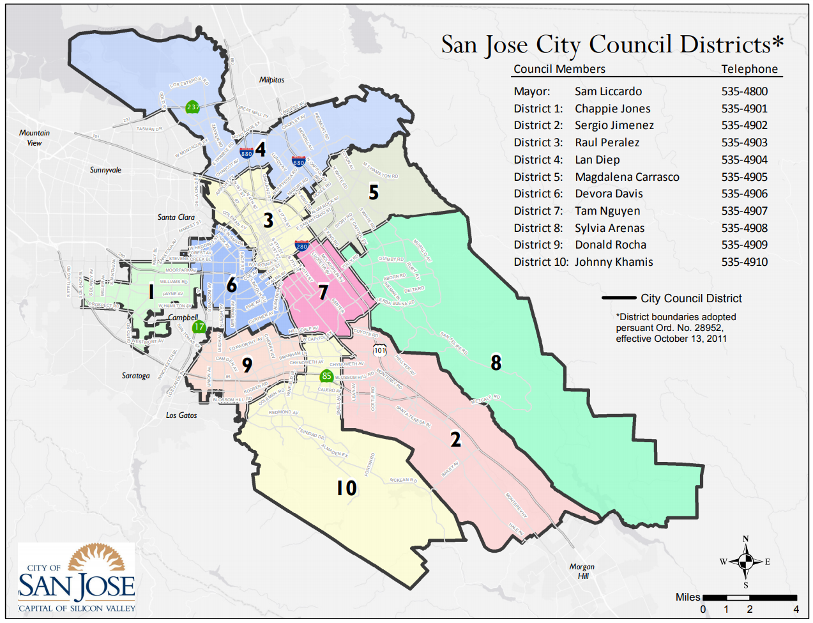
Commissioners
John Semanik
Alan Hinman Jr
Mimi Hernandez
Juan Estrada
Nia Celestin
Pete Kolstad
Jim Carter
Olivia Navarro
Jonathan Fleming
VACANT
Franklin Nguyen
Gary Cunningham
Nichole Edraos
VACANT
Michael Young
Terry Martin
Richard Giammona
Nick Labosky
David Wilkins
Perry Henry

Slide 10
Standard Relationship to City
elected
City
Manager
Mayor &
City Council
staff
public
City
Departments
City
Commissions
public input

Slide 11
N’ghbrhd C’msn Relationship to City
elected
City
Manager
Mayor &
City Council
staff
public
Neighborhoods
Commission
public input
Neighborhoods

Slide 12
You, the C’msn, and the Big Picture
City Manager
Mayor & City Council
Staff
Elected
Your Councilmember
The Neighborhoods Commission
Volunteers
Your District’s Commissioners
District Leadership Group
Your Neighborhood Association
You, the public

Slide 13
Types of N’ghbrhd C’msn Involvement
City
City
City
City
City
NC
NC
NC
NC
NC
NC
com’nty
com’nty
com’nty
com’nty
com’nty
Disseminate:
get info from City and share with the community
Collect:
get info
from the community
and share with City
Facilitate:
arrange for
City and
community
to exchange
info
Focus group:
City can get feedback from NC so as to
have better
presentation for community
Checked Box:
City claims it consulted the community
because it talked to NC
Diversion:
City appeases the public by having the community
meet with NC

Slide 14
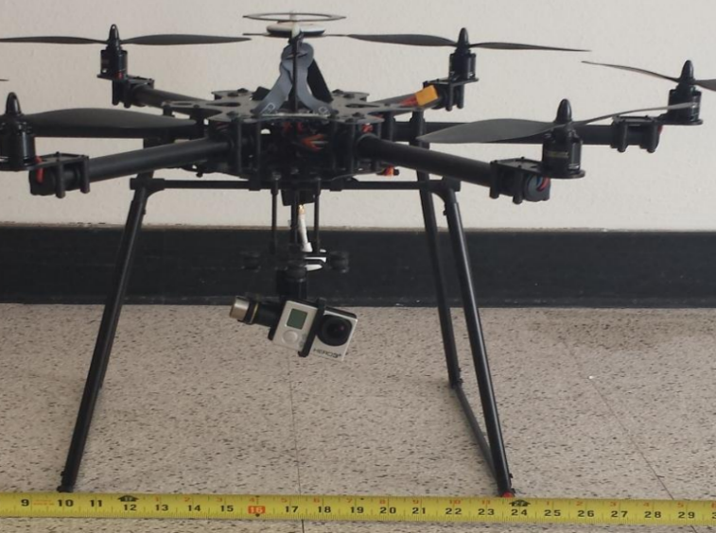
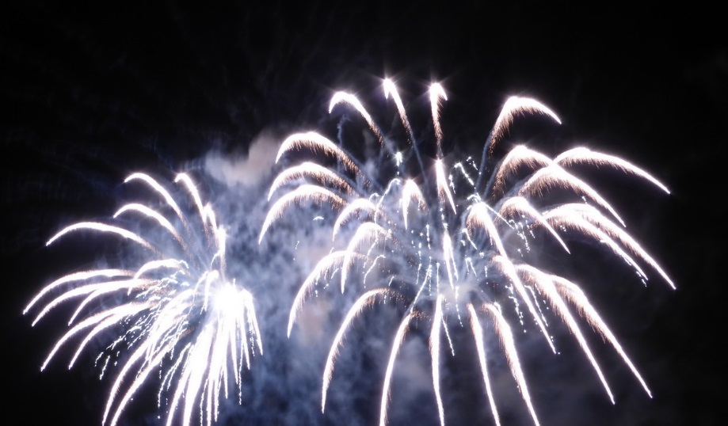
Past Accomplishments
City Policies: Trees, Out-Reach, Homelessness, Bylaws, Illegal dumping, ...
VTA & BART; transportation
Unmanned Aerial System (UAS, aka “Drones”)
Budget
Illegal Fireworks
$
?
$
?
$

Slide 15
Contact Information
Meetings are open to the public: Check www.SanJoseCA.gov website for agendas & schedules
Commission meetings are generally held on the 2nd Wed. (exc. July & Dec.), at 6:30 PM, in City Hall, Wing Rooms 118 and 119.
Informal notes & other materials on website: www.NeighborhoodsCommission.com/
NC Chair: Nichole Edraos

Slide 16
Question or comments?

